Slide 1
Azure SQL Data Warehouse – Key Performance Practices
Casey Karst
PM, Azure SQL Data Warehouse
cakarst@microsoft.com

Slide 2
Before we begin
Goals
Azure SQL Data Warehouse architecture reminder
Top “few” key performance influencers and guidance
Non-goals (but feel free to ask questions)
Make you a SQL DW expert
Give you a SQL DW performance magic wand
Every detail about SQL DW or SQL DW performance
Read every bullet in every slide
Pre-requisites
Working knowledge of SQL Data Warehouse

Slide 3
Architecture overview – reminder

Slide 4
Cloud: Separated Compute and Storage
Control
Compute
Remote
Storage
Notes:
Cloud Data Warehouses break the mold by separating compute from storage
Store as much data as you want
Pay for the performance you require
SQLDW introduces an automated cache that keeps a copy of your data close to the CPUs to maximise performance

Slide 5
Cloud: Separated Compute and Storage
Control
Compute
Intelligent
Cache
Remote
Storage
Notes:
Cloud Data Warehouses break the mold by separating compute from storage
Store as much data as you want
Pay for the performance you require
SQLDW introduces an automated cache that keeps a copy of your data close to the CPUs to maximise performance

Slide 6
Why was that important?
Azure SQL Data Warehouse is based on an MPP architecture, not SMP
Underlying engine is SQL Server but performance, scale and concurrency behaviors are very different
Size does matter and not in aggregate; individual table size and rowcount are important
Small data mart type workloads are generally poor candidates; exceptions are rare, few workarounds
OLTP reporting type workloads are usually poor candidates; some exceptions, some viable workarounds
If proper schema design was important in SQL Server, it is critical in SQL DW (or any MPP DW)

Slide 7
Loading data

Slide 8
Data Loading Recommendations
PolyBase, ADF and SSIS (with 2017 Azure feature pack) the fastest method
Upload to BLOB via AZCOPY or PowerShell library
Historical load – use CTAS
Incremental – use INSERT…SELECT
Use the highest resource/static class needed without sacrificing concurrency
Increase DWU during load, decrease when done
PolyBase now supports UTF-16 file types. ADLS as a source and target is also supported
Known Issues:
Does not support extended ASCII
Does not support custom multi-date format. E.g. 2000-1-6
No reject files/reason for rejected rows. (work in progress)

Slide 9
Data Loading Options
PolyBase
SSIS*
ADF
BCP
SQLBulkCopy API
Attunity Cloudbeam
ASA/Storm**
Method Performance | PolyBase | SSIS | ADF | BCP | SQL Bulkcopy
Rate
Rate increases with higher DWU | Yes | Yes* | Yes | No | No
Rate increases with more concurrent loads | No | No | No | Yes | Yes
Fastest Slowest
* With SSIS Azure Feature Pack June 2017 or newer
** Not a good idea

Slide 10
PolyBase characteristics
Single PolyBase load provides best performance for non-compressed files
Load performance scales as you increase service level objective
Automatically parallelizes data load process; no need to manually break the input data into multiple files and issue concurrent loads
Each reader will slice 512 MB block from data files
Max throughput depends on number of readers available on the DWU level
Multiple readers will not work against a compressed text file (gzip)
Only a single reader is used per compressed file since uncompressing the file in the buffer is single threaded
Alternatively, generate multiple compressed files
Number of files should be greater than or equal to the total number of readers of your service level objective (SLO)

Slide 11
Parallel load with Polybase
Compute Node
DMS
Bridge
Control Node
Compute Node
DMS
DMS
Azure Blob Storage (WASB)
Bridge
Compute Node
DMS
Bridge

Slide 12
Schema Design

Slide 13
Table Distribution Options
Hash
Round Robin
(Default)
Replicated
(Public Preview)
Data divided across nodes based on hashing algorithm
Same value will always hash to same distribution
Single column only
Data distributed evenly across nodes
Easy place to start, don’t need to know anything about the data
Simplicity at a cost
Data repeated on every node
Simplifies many query plans and reduces data movement
Best with joining hash table
Check for Data Skew, NULLS, -1
Will incur more data movement at query time
Consumes more space
Joining two Replicated Table runs
on one node

Slide 14
Selecting a Distribution Method
For large fact tables, best option is to Hash Distribute
Distribute on column that is joined to other fact tables
Primary or surrogate key
However, be mindful of …
Hash column should have highly distinct values (Minimum >60 distinct values)
Avoid distributing on a date column
Avoid distributing on column with high frequency of NULLs and default values (e.g. -1)
Distribution column is NOT updatable
For compatible joins use the same data types for two distributed tables
If there are no distribution columns that make sense, then use Round Robin as last resort

Slide 15
Dimension Table
Small dimension table (< 60M rows)
Clustered index
Round Robin
Replicated tables
Large dimension table
Same design as fact table
Clustered columnstore (by default) and distribute on join key

Slide 16
Data Movement
Data must be located on the same distribution to join…
Recommendation:
Design to minimize data movement
Mitigate data movement impact if unavoidable
Data Movement does not occur when
Two distribution compatible tables are joined
Aggregation is distribution compatible
Data Movement does occur when
Two distribution incompatible tables are joined
Round robin tables are distribution incompatible with all tables
Aggregation by nature is distribution incompatible

Slide 17
Optimizing with Indexes
Clustered ColumnStore (SQL DW Default)
Heap
Clustered Index
Optimal choice for large tables
Limits scans to columns in the query
Optimal compression
Slower to load than Heap
Keep partitions large enough to compress (> 1 million rows)
Optimal choice for temporary or staging tables
Fastest load performance
Optimal for tables < 60M rows
Sorting operation slows down load
Non-clustered Index
Use sparingly, reevaluate if moving from Gen1 to Gen2
Optimize single row lookups
Will slow down load

Slide 18
Statistics
Cost based Query Optimizer needs statistics
Create statistics for all columns used in JOINs, GROUP BY, WHERE
Update statistics after incremental load
If needed, use multi-column statistics on join and group by
Default sampled stats are usually fine except for very large tables
Auto create/update statistics currently in preview
create statistics l_orderkey on [dbo.lineitem] (l_orderkey);
select * from sys.stats where name = ‘l_orderkey’;
dbcc show_statistics ("lineitem","l_orderkey");

Slide 19
Partitioning
Partition on date column for archiving purposes
Improves performance by partition elimination
Partition Granularity depends on your workload
Reload, re-process
At least 1 million rows per distribution/partition
Optimize load performance through partition switching
Considers different grain partitions if you have hot/cold data in different tables
Example: Hot data daily, cold data monthly
Keep the number of partitions “reasonable” as there is overhead
Re-indexing by partition when needed

Slide 20

Row Store & Column Store

Slide 21
Row Store & Column Store & Partitioning

Slide 22
Row Store & Column Store & Partitioning

Slide 23
Querying

Slide 24
Key best practices
Create and update statistics
Statistics must be manually created and maintained.
Create “sampled” statistics on all columns in join, group by and where
Add multi-column statistics where join on multiple columns or predicates
Hash distribute large tables
Selecting the right distribution columns will minimize data movement
Use resources classes thoughtfully
Balance need for memory with need for concurrency
Not all queries benefit
Load large external tables rather than query
All data is brought back, no push down

Slide 25
Understanding customer’s workload
What is the system doing?
Small number of long running queries?
All queries share CPU and IO
Two queries running at the same time will take twice as long
High number of quick running queries?
What resource class?
What is your DWU?
Loads running concurrently with queries?
Object locks? Index rebuild?
Queue starvation?

Slide 26
Query Lifecycle
1. Query submitted
Submit time
2. Parsed
3. Optimized – Memo generated, plan chosen, check some perms
Start time
4. Object locks acquired
End Compile time
5. System locks acquired – wait for concurrency slots
6. Executed – more perms
End time

Slide 27
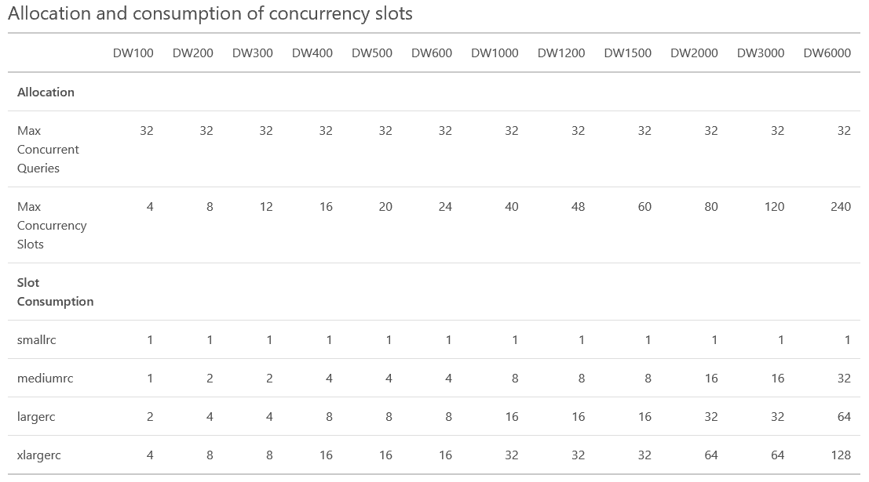
Concurrency Slots
Concurrency slots used depends on DWU and Resource Class

Slide 28
Understanding a Distributed SQL (DSQL) Plan
How to get a DSQL plan?
EXPLAIN
sys.dm_pdw_exec_requests (limited to 4000 characters)
Fundamental step types
OnOperation: T-SQL statement running on control or compute nodes
DMS: Data movement service (a process that runs on nodes)
Return: query executing on control or compute nodes and returning data
Each step type runs SQL
For DMS step, part of the execution time may be waiting for SQL

Slide 29
Questions to ask when looking at DSQL plan
What is taking the longest?
What is this step doing?
Does it make sense? This takes some time to learn.
What objects is the query using?
Tables
Statistics?
Distribution? Hash or Round Robin?
How many rows? Skew?
External Tables
No push down, consider loading
Views
What’s under the view?
Overloaded with joins?

Slide 30
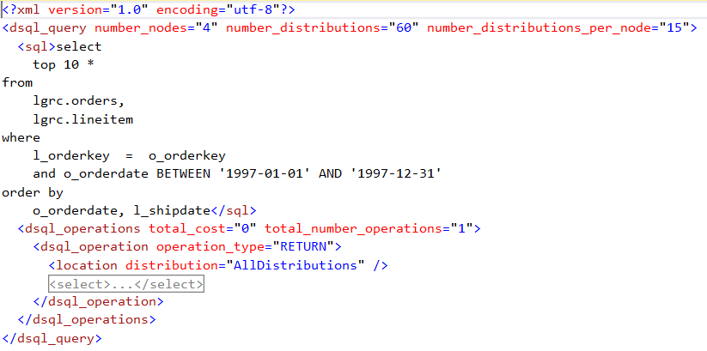
Example: Most Optimal plan
No aggregations
Query
Distribution compatible join
1 step
Just a return operation
“pass-through”
Search for dsql_operation operation_type
Optimal Plans tend to have fewer steps

Slide 31
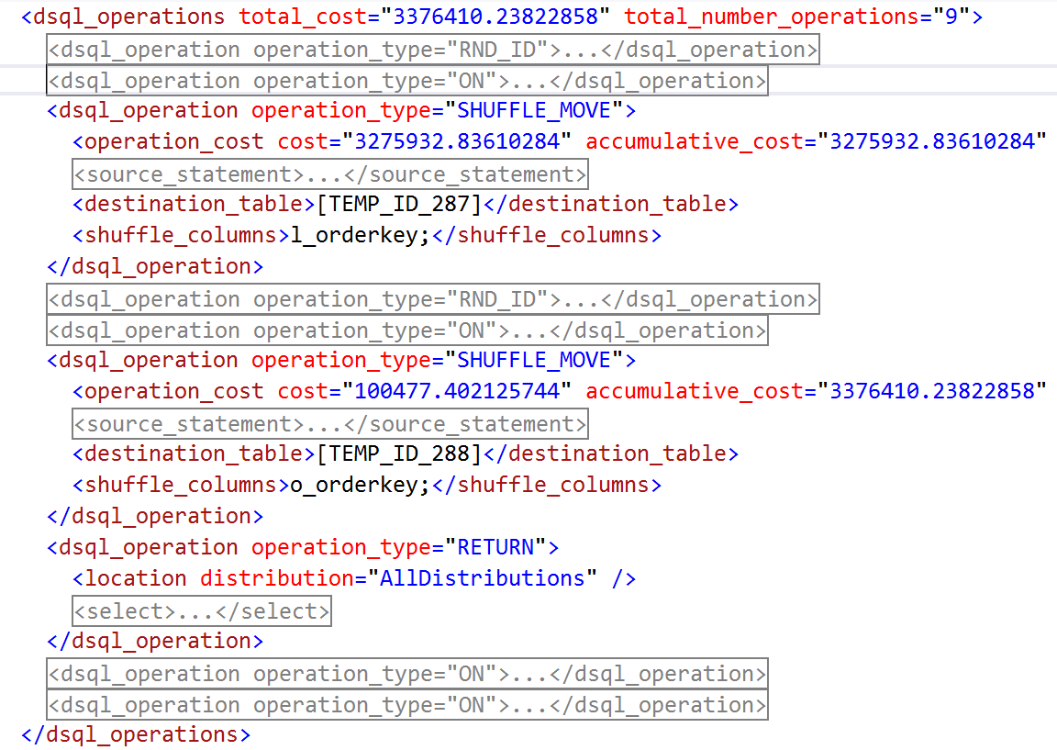
Example: Less optimal
9 steps
1
2
3
4
5
6
7
8
9
Important steps
2 shuffles
1 return
Overhead steps
Rnd_Id
Creates/Drops
Same query as last example except now both underlying tables are round robin

Slide 32
Common Data Movement Types
DMS Operation | Description
ShuffleMoveOperation | Redistributes data for compatible join or aggregation
PartitionMoveOperation | Data moves from compute to control node
BroadcastMoveOperation | Table needs to become replicated for join compatibility

Slide 33
Query Performance Recommendations
Check for SKEW (DBCC PDW_SHOWSPACEUSED)
Statistics
CETAS or CTAS large return operation
Denormalize Tables if needed
DSQL Query Plan
Minimize data movement operations
Distribution & aggregation compatible
Minimize size of data movement
Check for predicate pushdown. Rewrite query if needed
Use higher resource class for memory intensive queries
Load large external tables rather than querying directly
All data is brought back, no push down

Slide 34
SQLCAT Performance primitives
Operation | DWU400 (GB/HR) | DWU1000 (GB/HR) | DWU2000 (GB/HR) | DWU3000 (GB/HR) | DWU6000 (GB/HR)
Scan | 9,464 | 22,168 | 39,928 | 54,788 | 91,344
Load heap no partitioned | 584 | 1,172 | 2,657 | 3,397 | 6,993
Load CCI no partitioned | 440 | 1,038 | 2,225 | 3,381 | 6,024
Load CCI partitioned | 283 | 729 | 910 | 1,098 | 1,376
Shuffle | 410 | 879 | 1,458 | 1,709 | 2,021
CTAS copy | 958 | 1,874 | 2,814 | 2,831 | 3,083
Scan 40TB/HR
Load
7TB/Hr
Shuffle 410 GB/HR

Slide 35
Summary

Slide 36
Good performance basics
Pick the right workloads
Use the right tools for data loading large amounts of data
Limited optimizations for incremental loading
Select a good table distribution strategy
Pick right hash distribution column to minimize data movement
Avoid data skew because of distribution and query
Add and maintain statistics
Pick right sample for very large tables
Don’t overload your views
Query local tables, load external tables

Slide 37
Resources
https://blogs.msdn.microsoft.com/sqlcat/2017/09/05/azure-sql-data-warehouse-workload-patterns-and-anti-patterns/
https://blogs.msdn.microsoft.com/sqlcat/2017/05/17/azure-sql-data-warehouse-loading-patterns-and-strategies/
https://blogs.msdn.microsoft.com/sqlcat/2016/08/18/migrating-data-to-azure-sql-data-warehouse-in-practice/
https://docs.microsoft.com/en-us/azure/sql-data-warehouse/sql-data-warehouse-best-practices
Azure SQL Data Warehouse lessons learned and practical implementation tips
Getting peak performance from your SQL Data Warehouse column store

